Slide 1
Loan defaulter analysis
Dhruv Rakesh mentored by Alexander George ( AFFINE ANALYTICS )

Slide 2
Project summary
Objective:
To analyze the credit history of a user and to predict if the user is a suitable candidate for a small ticket loan.
High Level Approach:
Binary Classification using Machine Learning Model. (Logistic Regression).
Data:
User Profile data, Loan history of each user.
Tech Stack:
Python and Excel.
Final Outcome:
In conclusion, 12813 unique user profiles and their loan history were analysed in order to produce a result.
Achieved an accuracy of 81.62% in predicting if a user will default loan.

Slide 3
High Level Approach
Data was aggregated
Exploratory data analysis was done in which distributions of various parameters of credit history and user profile data were studied. Using this missing data was imputed as well as redundant data was dropped.
Univariate analysis was done which showed insights into each variable of the data set. Bivariate and multivariate analysis was done in order to study relation between two or more variables.
Variable selection was done after studying the correlation and p-values of the features after which model was made using logistic regression.
The accuracy score as well as the required confusion matrix was studied in order to optimize results and obtain the desired output.

Slide 4
Data provided
User Profile Data:
This table contained records pertaining to each user. It included variables such as salary, requested amount, date of birth, monthly expense, type of residence and purpose of the loan.
Loan History Data:
This data includes key factors such as current loan balance, number of loans pending, type of loans taken, EMI of pending loans, interest rates, repayment tenure, ownership and collateral value/type.
Defaulting factors such as suit filed wilful default and loans written off or loans settled.
It also consisted of the payment schedule of the loans and the days past due for each month up to 36 months.

Slide 5
Logistic Regression
Data Pre-processing
Data Exploration
Extraction Transformation and Loading
Modelling
Analytical Dataset Creation
Random Forest Classifier
K Nearest Neighbour

Slide 6
Data pre-processing
Firstly, a primary key was chosen which in this case was selected as uniqueID. The uniqueID was also a foreign key and connected the user profile data and the loan history data.
Next, capitalisation issues were solved as well as incorrect data was fixed. The categorical data columns which had too many categories, number of categories were reduced.
Null values that cannot be imputed decision on whether that column has to be dropped or the particular record was to be dropped was taken.
Flags were set for users that defaulted.
If payment was delayed in any given month by more than 90 days ( days past due > 90) the loan was considered as defaulted.
If loan was written off or was a suit filed wilful default they were flagged as defaulted.

Slide 7
Data Exploration
Univariate analysis was done on each variable to study the distribution of the data.
This univariate analysis described the data, showing their mean, median, standard deviation, minimum and maximum value as well as their interquartile range.
Bivariate analysis was done to see the relation of each variable with the target variable (loan_default) as well as other variables.
The correlation of the different variables were studied and variables with correlation greater than 0.8 were dropped while making the modelling table.

Slide 8
Extraction, Transformation And loading
Both tables were joined using the uniqueID column such that each user has a unique record. Duplicates were dropped.
Current balance of each loan for a particular user from the loan history table were summed up as a single current balance.
Number of loans a user took also was calculated.
Decision was made on previous default, if a user defaulted any one of their previous loans the previous default column was flagged.
All the loans a user took before the latest loan they were aggregated and flags were set.

Slide 9
Analytical dataset creation:
Final model table was made after dropping the redundant or incomplete variables.
Feature selection was done using :
Feature Importance:
Feature importance was checked and out of 21 features the 10 best features were selected.
Correlation was checked and if any two variables had a correlation greater than 0.8 one of them were dropped.
The p-value of the feature was another determining factor in choosing the variables. If any variable had a p-value>0.05 it was dropped

Slide 10
modelling
3 Modelling techniques were tried:
Logistic Regression
Random Forest Classifier
K-Nearest Neighbour

Slide 11
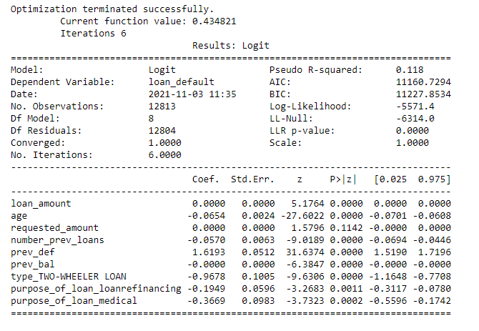
Logistic Regression
Using Logistic Regression:
A test accuracy of 81.61% at a threshold of 0.47 was achieved in classifying whether a user defaulted.
Confusion Matrix of test case:
The confusion matrix is divided into 4 cells: True Positives, True negatives, False Positives, True Negatives.
In our case, False negatives refer to users who don’t default but the model shows that they default, whereas False Positives are users who default but are shown as non defaulters by the model.
Our aim is to reduce these two columns as much as possible without reducing our accuracy score. (False Negatives and False Positives).
 | Positives | Negatives
Positives | 2506 | 81
Negatives | 508 | 109

Slide 12
Random forest classifier
Using Random Forest Classifier:
A test accuracy score of 80.30% was achieved in predicting if a user defaults their loan.
Confusion Matrix for test case:
Though the accuracy score is very close to the logistic regression model the False Negatives as well as the False positives are higher which results in a higher factor risk to the lender as well as a lower sale of his product since the False negatives are higher.
 | Positives | Negatives
Positives | 2475 | 112
Negatives | 519 | 98

Slide 13
K nearest neighbour
Using K nearest neighbour:
Test set accuracy of 79.93% was achieved in predicting if a user defaults their loan.
Confusion Matrix for test case:
Though this model is able to show most number of True negatives which helps us it also has a very high number of False negatives which will result in a loss of business.
 | Positives | Negatives
Positives | 2396 | 191
Negatives | 470 | 147

Slide 14
Final outcome
After evaluating all models the logistic regression model was chosen for classifying loan defaulters as it was able to the highest accuracy score as well as was able to keep our False negatives and False positives minimal.
Our main aim is to provide a solution which will help maximise the sale of the small ticket loan at the same time reduce the risk factor to the lender.

Slide 15
THANK YOU
Dhruv Rakesh​
+91 9880366425
dhruvrakesh23@gmail.com

